Slide 1
Model Selection

Slide 2
Data Set

Slide 3
Data Set
Train/Test Split
Training Set
Test Set
70%
30%

Slide 4
Data Set
Training Set
70%

Slide 5
Training Set

Slide 6
K-fold Cross Validation
Training Set

Slide 7
10-fold Cross Validation
1 | 2 | 3 | 4 | 5 | 6 | 7 | 8 | 9 | 10

Slide 8
10-fold Cross Validation
1 | 2 | 3 | 4 | 5 | 6 | 7 | 8 | 9 | 10
validation set

Slide 9
10-fold Cross Validation
1 | 2 | 3 | 4 | 5 | 6 | 7 | 8 | 9 | 10
1 | 2 | 3 | 4 | 5 | 6 | 7 | 8 | 9 | 10
validation set

Slide 10
10-fold Cross Validation
1 | 2 | 3 | 4 | 5 | 6 | 7 | 8 | 9 | 10
1 | 2 | 3 | 4 | 5 | 6 | 7 | 8 | 9 | 10
1 | 2 | 3 | 4 | 5 | 6 | 7 | 8 | 9 | 10
validation set

Slide 11
10-fold Cross Validation
1 | 2 | 3 | 4 | 5 | 6 | 7 | 8 | 9 | 10
1 | 2 | 3 | 4 | 5 | 6 | 7 | 8 | 9 | 10
1 | 2 | 3 | 4 | 5 | 6 | 7 | 8 | 9 | 10
1 | 2 | 3 | 4 | 5 | 6 | 7 | 8 | 9 | 10
1 | 2 | 3 | 4 | 5 | 6 | 7 | 8 | 9 | 10
1 | 2 | 3 | 4 | 5 | 6 | 7 | 8 | 9 | 10
1 | 2 | 3 | 4 | 5 | 6 | 7 | 8 | 9 | 10
1 | 2 | 3 | 4 | 5 | 6 | 7 | 8 | 9 | 10
1 | 2 | 3 | 4 | 5 | 6 | 7 | 8 | 9 | 10
1 | 2 | 3 | 4 | 5 | 6 | 7 | 8 | 9 | 10

Slide 12
10-fold Cross Validation
1 | 2 | 3 | 4 | 5 | 6 | 7 | 8 | 9 | 10
.69
1 | 2 | 3 | 4 | 5 | 6 | 7 | 8 | 9 | 10
.64
1 | 2 | 3 | 4 | 5 | 6 | 7 | 8 | 9 | 10
.73
1 | 2 | 3 | 4 | 5 | 6 | 7 | 8 | 9 | 10
.82
1 | 2 | 3 | 4 | 5 | 6 | 7 | 8 | 9 | 10
.64
1 | 2 | 3 | 4 | 5 | 6 | 7 | 8 | 9 | 10
.70
1 | 2 | 3 | 4 | 5 | 6 | 7 | 8 | 9 | 10
.68
1 | 2 | 3 | 4 | 5 | 6 | 7 | 8 | 9 | 10
.71
1 | 2 | 3 | 4 | 5 | 6 | 7 | 8 | 9 | 10
.70
1 | 2 | 3 | 4 | 5 | 6 | 7 | 8 | 9 | 10
.69

Slide 13
10-fold Cross Validation
1 | 2 | 3 | 4 | 5 | 6 | 7 | 8 | 9 | 10
.69
1 | 2 | 3 | 4 | 5 | 6 | 7 | 8 | 9 | 10
.64
1 | 2 | 3 | 4 | 5 | 6 | 7 | 8 | 9 | 10
.73
1 | 2 | 3 | 4 | 5 | 6 | 7 | 8 | 9 | 10
.82
1 | 2 | 3 | 4 | 5 | 6 | 7 | 8 | 9 | 10
.64
1 | 2 | 3 | 4 | 5 | 6 | 7 | 8 | 9 | 10
.70
1 | 2 | 3 | 4 | 5 | 6 | 7 | 8 | 9 | 10
.68
1 | 2 | 3 | 4 | 5 | 6 | 7 | 8 | 9 | 10
.71
1 | 2 | 3 | 4 | 5 | 6 | 7 | 8 | 9 | 10
.70
1 | 2 | 3 | 4 | 5 | 6 | 7 | 8 | 9 | 10
.69

Slide 14
Logistic Regression
Fold 1 | Fold 2 | Fold 3 | Fold 4 | Fold 5 | Fold 6 | Fold 7 | Fold 8 | Fold 9 | Fold 10 | Mean
.69 | .64 | .73 | .82 | .64 | .70 | .68 | .71 | .70 | .69 | .70

Slide 15
Logistic Regression
Fold 1 | Fold 2 | Fold 3 | Fold 4 | Fold 5 | Fold 6 | Fold 7 | Fold 8 | Fold 9 | Fold 10 | Mean
.69 | .64 | .73 | .82 | .64 | .70 | .68 | .71 | .70 | .69 | .70

Slide 16
Logistic Regression
Fold 1 | Fold 2 | Fold 3 | Fold 4 | Fold 5 | Fold 6 | Fold 7 | Fold 8 | Fold 9 | Fold 10 | Mean
.69 | .64 | .73 | .82 | .64 | .70 | .68 | .71 | .70 | .69 | .70

Slide 17
Logistic Regression
Fold 1 | Fold 2 | Fold 3 | Fold 4 | Fold 5 | Fold 6 | Fold 7 | Fold 8 | Fold 9 | Fold 10 | Mean
.69 | .64 | .73 | .82 | .64 | .70 | .68 | .71 | .70 | .69 | .70

Slide 18






















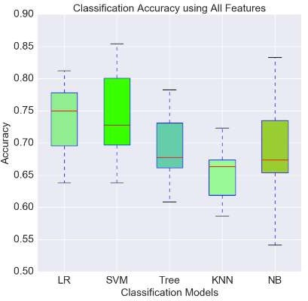

0.705

Slide 19
Model Evaluation Metrics

Slide 20


































Slide 21
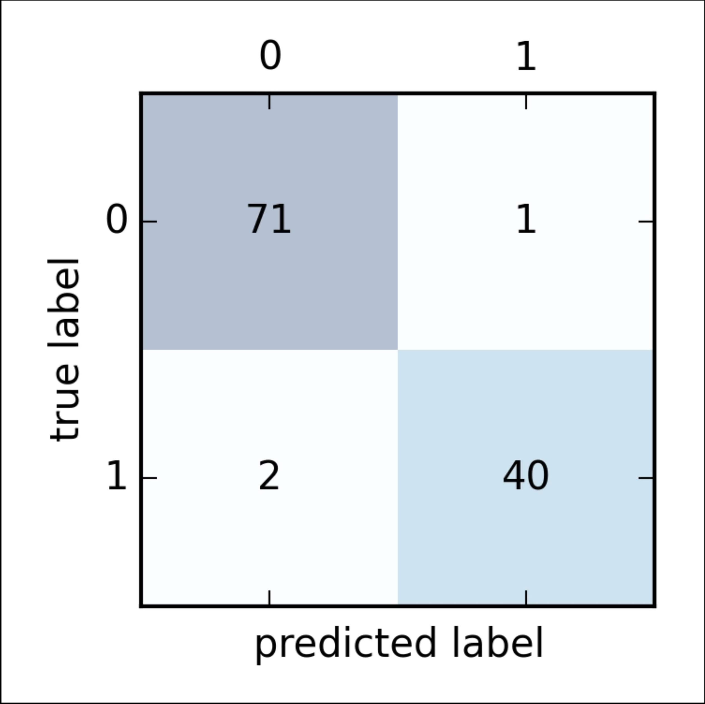
true class

Slide 22










true class

Slide 23









true class

Slide 24
Accuracy
true class

Slide 25
Precision
true class

Slide 26
Recall
true class

Slide 27








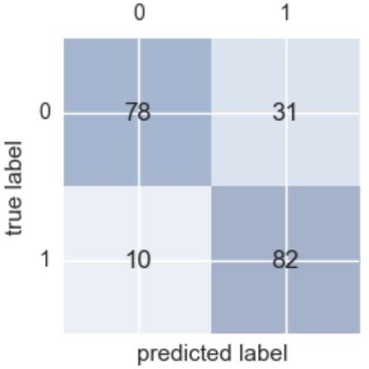




Slide 28




Slide 29




Slide 30
















Slide 31
Training Set
1 | 2 | 3 | 4 | 5 | 6 | 7 | 8 | 9 | 10

Slide 32
Data Set
Training Set
Test Set
70%
30%

Slide 33
Data Set
Training Set
Test Set
30%

